Slide 2
Unit Objectives
Define web design software
Start Adobe Dreamweaver CS6
View the Dreamweaver workspace
Work with views and panels
Open a web page
View web page elements
Get help
View a web page in a browser
Close a web page and exit Dreamweaver

Slide 3
Defining Web Design Software
Using Dreamweaver, you can:
Create web pages or websites
Add text, images, tables, media files
Display web pages as they will appear to users
Use the Property inspector to view and edit page elements
Manage web sites

Slide 4
Defining Web Design Software

Slide 5
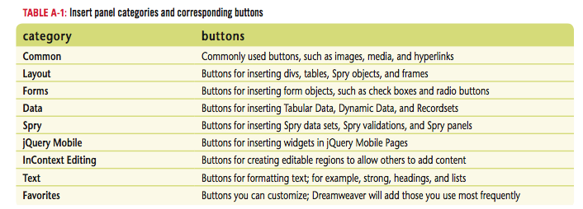
Defining Web Design Software

Slide 6
Starting Adobe Dreamweaver CS6
Windows
Click the Start button on the taskbar
Point to All Programs, click Adobe Web Premium CS6 or Adobe Design Premium CS6, then click Adobe Dreamweaver CS6
Click HTML in the Create New column on the Dreamweaver Welcome Screen

Slide 7
Starting Adobe Dreamweaver CS6
Mac
Click Finder in the dock, then click Applications
Click the Adobe Dreamweaver CS6 folder, then double-click the Dreamweaver CS6 program
Click HTML in the Create New column on the Dreamweaver Welcome Screen

Slide 8
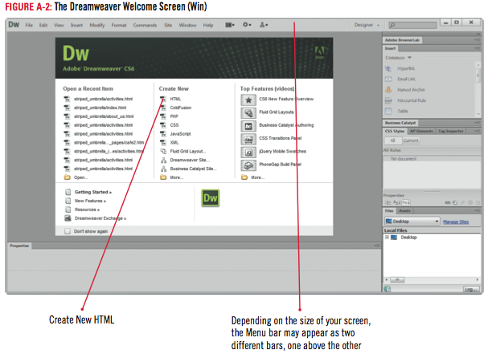
Starting Adobe Dreamweaver CS6

Slide 9
Clues to Use
Using Dreamweaver layouts
Designer layout
Panels docked on right
Coder layout
Panels docked on left
Dual Screen layout
Use with two monitors
Change the workspace layout by using Workspace switcher

Slide 10
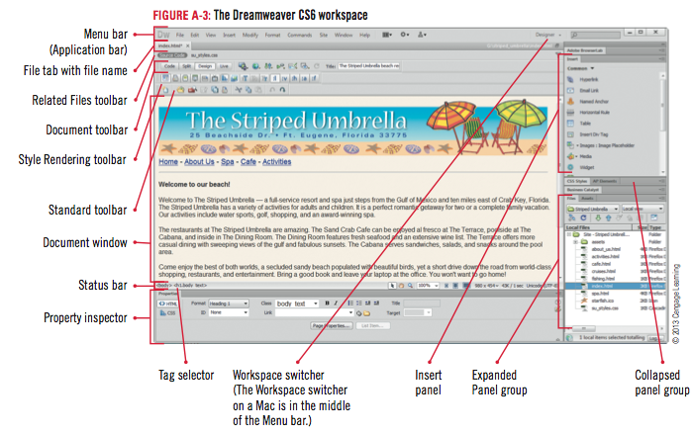
Viewing the Dreamweaver Workspace

Slide 11
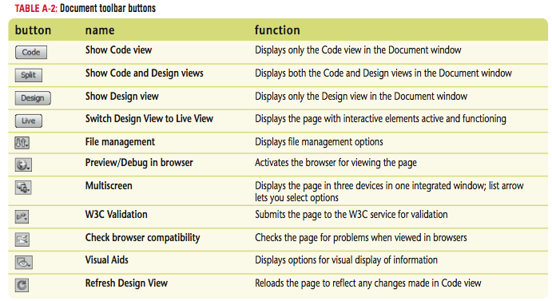
Viewing the Dreamweaver Workspace

Slide 12
Working with Views and Panels
Click the Show Code view button on the Document toolbar
Click the Show Code and Design views button on the Document toolbar
Click the Show Design view button on the Document toolbar
Double-click the CSS Styles panel tab (if necessary) to expand the panel group

Slide 13
Working with Views and Panels
Click the AP Elements panel tab on the CSS Styles panel group
Click the CSS Styles panel tab to display it, then double-click it
Click File on the Menu bar, click Close to close the document, then click No if necessary when asked about saving the untitled page

Slide 14
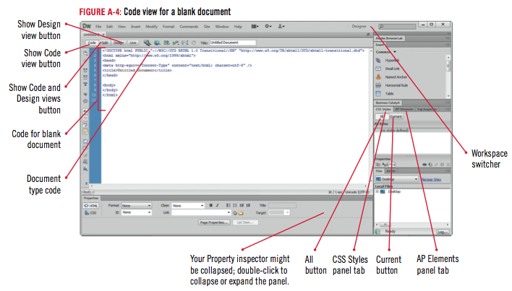
Working with Views and Panels

Slide 15
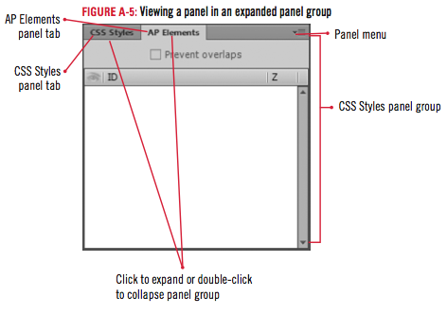
Working with Views and Panels

Slide 16
Clues to Use
Using panel groups
Five panel groups open when you first start Dreamweaver:
Adobe BrowserLab panel
Insert panel
CSS Styles panel group
Business Catalyst panel
Files panel group
Retain arrangement from one session to the next
The panel group title bar is the dark gray bar at the top of each panel group

Slide 17
Opening a Web Page
Click File on the Menu bar, then click Open
Click the Look in list arrow (Win) or click the Current file location list arrow (Mac), navigate to the drive and folder where your Data Files are stored, then double-click (Win) or click (Mac) the unit_a folder
Click dwa_1.html, then click Open

Slide 18
Opening a web Page
If necessary, click the Maximize button on the Document window title bar
Click the Show Code view button on the Document toolbar
Scroll through the code, click the Show Design view button to return to Design view, then, if necessary, scroll to display the top of the page

Slide 19
Design Matters
Opening or creating different document types with Dreamweaver
HTML
XML
Style sheets
Text files

Slide 20
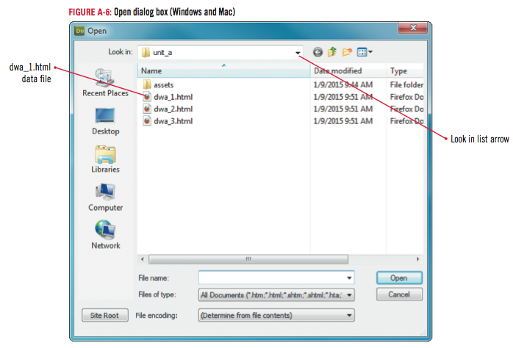
Opening a Web Page

Slide 21
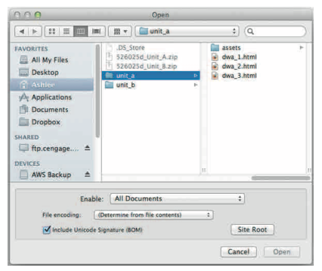
Opening a Web Page

Slide 22
Clues to Use
Displaying and docking panel groups
You can move panel groups by dragging the panel group title bar
Dock a panel group by dragging it back to the right side of the screen
A heavy blue bar indicates the position it will take when you release the mouse
Position called the drop zone

Slide 23
Viewing Web Page Elements
Text
Images
Hyperlinks
Tables
Divs and AP Divs
Flash Movies
Flash Video

Slide 24
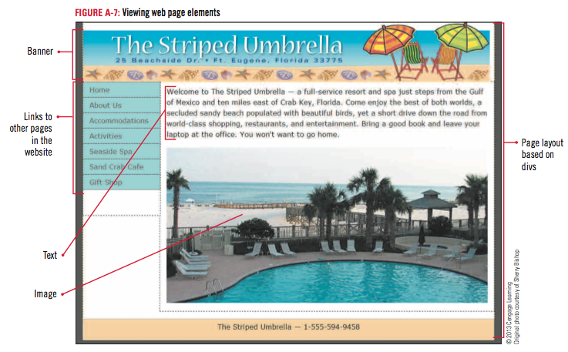
Viewing Web Page Elements

Slide 25
Viewing web Page Elements

Slide 26
Getting Help
Click Help on the Menu bar
Click Dreamweaver Help
Type “workspace switcher” in the search box, click the drop-down menu, click Dreamweaver if necessary, then press [Enter]
Click the option button next to “Only Adobe content”
Click one of the links listed
Scroll through and read some of the information, then close the Dreamweaver Help window

Slide 27
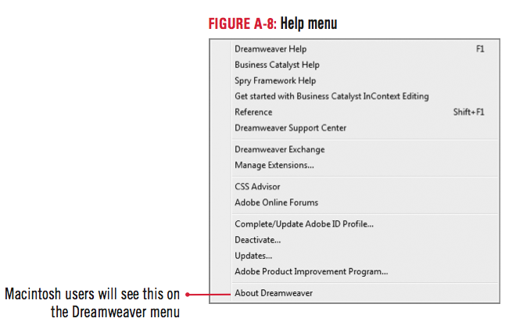
Getting Help

Slide 28
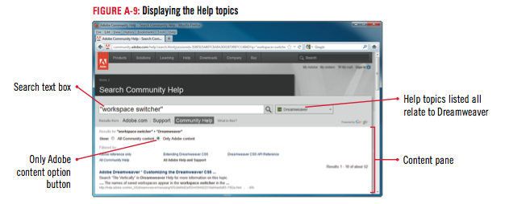
Getting Help

Slide 29
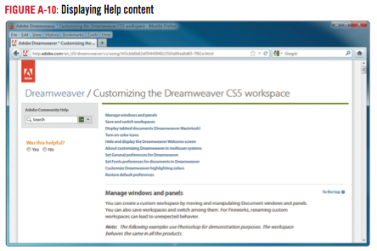
Getting Help

Slide 30
Viewing a Web Page in a Browser
in Design view, click the Maximize button (Win) or (Mac) on the Menu bar, then click the Window size pop-up menu on the right side of the status bar
Click 1000× 620 (1024 × 768, Maximized)
Click the Preview/Debug in Browser button on the Document toolbar, then click Preview in [browser name]
Click File on the browser menu bar, then click Print
Click Print

Slide 31
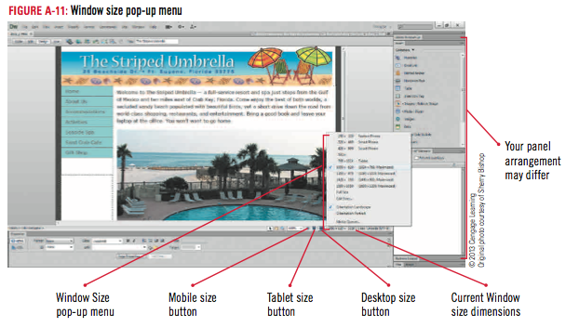
Viewing a Web Page in a Browser Window

Slide 32
Viewing a Web Page in a Browser Window

Slide 33
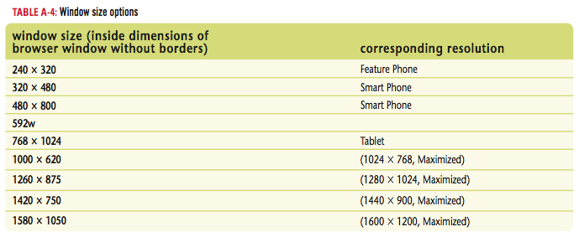
Viewing a Web Page in a Browser Window

Slide 34
Closing a Web Page and Exiting Dreamweaver
In the browser, click File on the Menu bar, then click Exit (Win), or click [Browser name] on the Menu bar, then click Quit [Browser name] (Mac)
In the Dreamweaver workspace, click File on the Application bar, then click Exit (Win) or click Dreamweaver on the Menu bar, then click Quit Dreamweaver (Mac)

Slide 35
Clues to Use
Saving and closing Dreamweaver files
Save files frequently as you work
Filename is “Untitled” until you save
An asterisk appears next to the file name in Dreamweaver if you have unsaved changes

Slide 36
Design Matters
You should have a design plan in place for tablet sizes and mobile phone sizes in both portrait and landscape modes
Gestures are interactions with a touchscreen, usually with a combination of fingers and a thumb
Dreamweaver can help you develop a design plan for multiple window sizes with the new Fluid Grid Layout, a system for designing an adaptive website based on a single fluid grid

Slide 37
Unit Summary
Define web design software
Start Adobe Dreamweaver CS6
View the Dreamweaver workspace
Work with views and panels
Open a web page
View web page elements
Get help
View a web page in a browser
Close a web page and exit Dreamweaver

